Slide 1
CS 4530 & CS 5500
Software Engineering
Lesson 8.3: Continuous Delivery
Jonathan Bell, Adeel Bhutta, Ferdinand Vesely, Mitch Wand
Khoury College of Computer Sciences © 2022, released under CC BY-SA

Slide 2
Learning Objectives for this Lesson
By the end of this lesson, you should be able to…
Describe how continuous delivery helps to catch errors sooner in a product’s lifecycle
Describe the distinction between a DevOps and “traditional” developer/operator mentality
Describe strategies for performing quality-assurance on software as and after it is delivered

Slide 3
Cost to Fix a Defect Over Time
Rough estimate
Today: How do we catch defects just at the inflection point of this curve?
Notes:
Review: Why expensive as move to the right?
Need to be triaged by someone who doesn’t know (or doesn’t remember)
Might now need more work, since code has changed around the bug
Has a greater impact - who wants to read about their bug on the front page of the newspaper?
So far: edit-compile-debug loop of local development, continuous integration.
Now consider:
Bug reports by internal users who are opted in to a feature before external users
Bug or outage reports by external users
Can we develop a process to detect these defects and resolve them before they have a greater impact?

Slide 4


Deploying New Code
The best that we can hope for?
“If stuff blows up it affects a very small percentage of people”
Instagram cofounder and CTO Mike Krieger
https://www.fastcompany.com/3047642/do-the-simple-thing-first-the-engineering-behind-instagram

Slide 5
Continuous Delivery
“Faster is safer”: Key values of continuous delivery
Release frequently, in small batches
Maintain key performance indicators to evaluate the impact of updates
Phase roll-outs
Evaluate business impact of new features
Notes:
Thanks to the automated software integration pipeline that we’ve built, we can now work on closing the last feedback loop: by delivering our updates frequently, we can observe the impact of each update in relative isolation. We can be agile - releasing frequently, in small batches of updates. Thanks to automation from our CI + infrastructure system, we should be able to release with relatively low human overhead. We can maintain performance indicators like crashes, or latency and work on improving them. We can roll-out these changes to just a few users before shipping to everyone, and use this data to help determine if we should do that roll-out or not. We can even use this approach to evaluate whether newly designed features are used by users as our product designers intended - for instance, if we are implementing improvements to the usability of a commenting system, we might measure whether there are more comments made using the new feature or not. There are a few tricks that we can use to make this all work (and not make our software worse).

Slide 6
Staging Environments
Enabling Continuous Delivery
As software gets more complex with more dependencies, it's impossible to simulate the whole thing when testing
Idea: Deploy to a complete production-like environment, but don't have everyone use it
Examples:
“Eat your own dogfood”
Beta/Alpha testers
Lower risk if a problem occurs in staging than in production
Notes:
A key pre-requisite for continuous delivery is a staging environment .(read slide)

Slide 7

Test-Stage-Production
Continuous Delivery in Action
Developer Environments
Beta/Dogfooding
User Requests
Testing Environment
Staging Environment
Production Environment
Revisions are “promoted” towards production
Q/A takes place in each stage (including production!)
Notes:
These different deployment environments create a “deployment pipeline”, where code changes get “promoted” from one level of deployment to the next.
The “testing environment” is perhaps the developers’ local machines, and provides a reasonable baseline for running tests, but it would be hard to have many other users be testing our software from that one developer’s computer, and it also would probably be hard to setup ALL of the services necessary to really make a “deployment-like” environment on each developer’s local computer.
The “staging environment” is usually a production-like environment, consisting of all of the same services that are in production, but perhaps deployed at a smaller scale.
At each deployment step, there are extensive Q/A processes that help ensure confidence that the software is ready to ship.
Most continuous delivery pipelines involve at least these three phases, but in practice, there may be many staging environments, and several versions of the software deployed in production concurrently.

Slide 8
A/B Deployments with Canaries
Mitigating risk in continuous delivery
Monitor both:
But minimize impact of problems in new version
Notes:
Another typical strategy used in continuous delivery are A/B deployments. With A/B deploymernts, the production environment actually runs multiple versions of the code. Most users see the old version, but some users see the new version. Automated systems can monitor metrics from both deployments – all kinds of metrics, ranging from memory consumption to response time to overall user satisfaction. This approach might be called “testing in production” - and key to it is that even if a problem is detected in the new version, the user’s request could still be satisfied by the old version.

Slide 9
Operations Responsibility
DevOps in a slide
Once we deploy, someone has to monitor software, make sure it’s running OK, no bugs, etc
Assume 3 environments:
Test, Staging, Production
Whose job is it?
 | Developers | Operators
Waterfall
Agile
DevOps
Test
Staging
Production
Test
Staging
Production
Production
Production
Test
Staging
Notes:
The idea of “devops” is core to enabling this kind of deployment pipeline. In traditional “waterfall” models of software development, developers are responsible for one thing: writing the software. Not even testing it – you have a separate QA team, and you have a separate operations team.
In agile development, the developers will be responsible for writing (and running) their own tests, but it is not necessarily the case that developers are held responsible for operating the service. We might have a fully separate team responsible for that.
In “DevOps”, we create automated tooling to make it so that every developer can (in principle) be an operator of the software. If every developer is empowered with the ability to create their own staging environment on-demand, then we can scale this idea of continuous delivery up as we grow our development team.
This is not to say that there are no individuals who are dedicated to “operating” the software in deployment: these roles still certainly exist, and a common title might be ”site reliability engineer” – but just like developers are empowered in DevOps to deploy their own staging environments, operators are empowered to understand the software and debug infrastructure-related issues.

Slide 10
Release Pipelines
How quickly is my change deployed?
Even if you are deploying every day, you still have some latency
A new feature I develop today won't be released today
But, a new feature I develop today can begin the release pipeline today (minimizes risk)
Release Engineer: gatekeeper who decides when something is ready to go out, oversees the actual deployment process
Notes:
(read slide). Important bit is that there is latency to get to production – start dogfooding right away, but not re

Slide 11
Deployment Example: Facebook.com
Pre-2016
Developers working in their own branch
When feature is ready, push as 1 change to master branch
~1 week of development
~1 week of development
master branch
All changes that survived stabilizing
3 days
4 days
Weekly
Stabilize
Release Branch
All changes from week
that are ready for release
release branch
production
Your change doesn’t go out unless you’re there that day at that time to support it!
3x Daily
“When in doubt back out”
Notes:
https://engineering.fb.com/2017/08/31/web/rapid-release-at-massive-scale/
This chart shows the overall process that was used before 2016 to deploy Facebook.com. (read diagram; important bits: dev branches get merged into master, then once a week all changes from the past week are pulled into a release branch. For 3 days they “stabilize” the release branch – find changes that are causing very bad behavior and back them out. Then for the last 4 days of the week, every change that survived that stabilization gets individually pushed to production batched so that this happens 3x/day. Important to do small deploys so that you can isolate bad changes)
What was bad about this? Didn’t scale. How many changes going out? 500-700 PER DAY. By 2016 might be pushing 10k diffs per week. ENORMOUS effort to co-ordinate (between the “your change doesn’t go out unless you’re there to support it” and “when in doubt back it out” – both very manual)
(From the blog post):
For many years, we pushed the Facebook front end three times a day using a simple master and release branch strategy. Engineers would request cherry-picks — changes to the code that had passed a series of automated tests — to pull from the master branch into one of the daily pushes from the release branch. In general, we saw between 500 and 700 cherry-picks per day. Once a week, we’d cut a new release branch that picked up any changes that were not cherry-picked during the week.
By 2016, we saw that the branch/cherry-pick model was reaching its limit. We were ingesting more than 1,000 diffs a day to the master branch, and the weekly push was sometimes as many as 10,000 diffs. The amount of manual effort needed to coordinate and deliver such a large release every week was not sustainable.

Slide 12
Deployment Example: Facebook.com
Chuck Rossi, Director Software Infrastructure & Release Engineering @ Facebook
“Our main goal was to make sure that the new system made people’s experience better — or at the very least, didn’t make it worse. After almost exactly a year of planning and development, over the course of three days in April 2017 we enabled 100 percent of our production web servers to run code deployed directly from master.”
“Rapid release at massive scale” https://engineering.fb.com/2017/08/31/web/rapid-release-at-massive-scale/
Notes:
So, Facebook re-architected their release process. (pause to read quote)

Slide 13
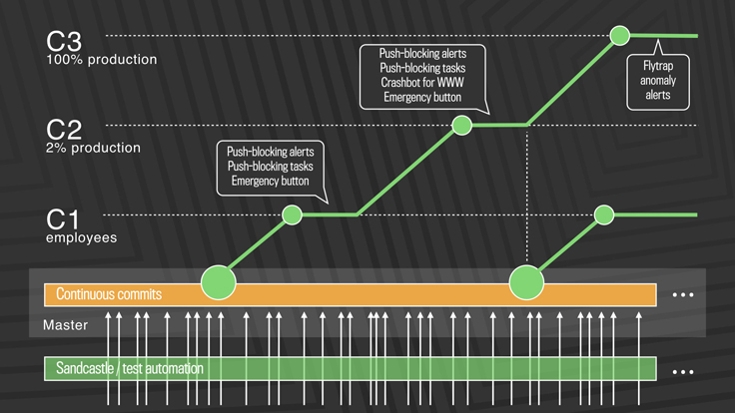
Deployment Example: Facebook.com
Post-2016: Truly continuous releases from master branch
https://engineering.fb.com/2017/08/31/web/rapid-release-at-massive-scale/
Notes:
This approach solves the problem of scaling continuous delivery. In Facebook’s new deployment model, there is no manual cherry-picking, and there are automated processes to detect anomalies and revert changes. There are three-tiers of deployment, from C1 (dog-fooding/staging) to C2 (deployment to a small slice of production) to C3 (deployment to entirety of production workload)
The process works like this: (copied from blog post)
First, diffs that have passed a series of automated internal tests and land in master are pushed out to Facebook employees. In this stage, we get push-blocking alerts if we’ve introduced a regression, and an emergency stop button lets us keep the release from going any further. If everything is OK, we push the changes to 2 percent of production, where again we collect signal and monitor alerts, especially for edge cases that our testing or employee dogfooding may not have picked up. Finally, we roll out to 100 percent of production, where our Flytrap tool aggregates user reports and alerts us to any anomalies.
Many of the changes are initially kept behind our feature flags, which allows to roll out mobile and web code releases independently from new features, helping to lower the risk of any particular update causing a problem. If we do find a problem, we can simply switch the feature off rather than revert back to a previous version or fix forward.

Slide 14
Monitoring
The last step in continuous deployment: track metrics
Hardware
Voltages, temperatures, fan speeds, component health
OS
Memory usage, swap usage, disk space, CPU load
Middleware
Memory, thread/db connection pools, connections, response time
Applications
Business transactions, conversion rate, status of 3rd party components

Slide 15
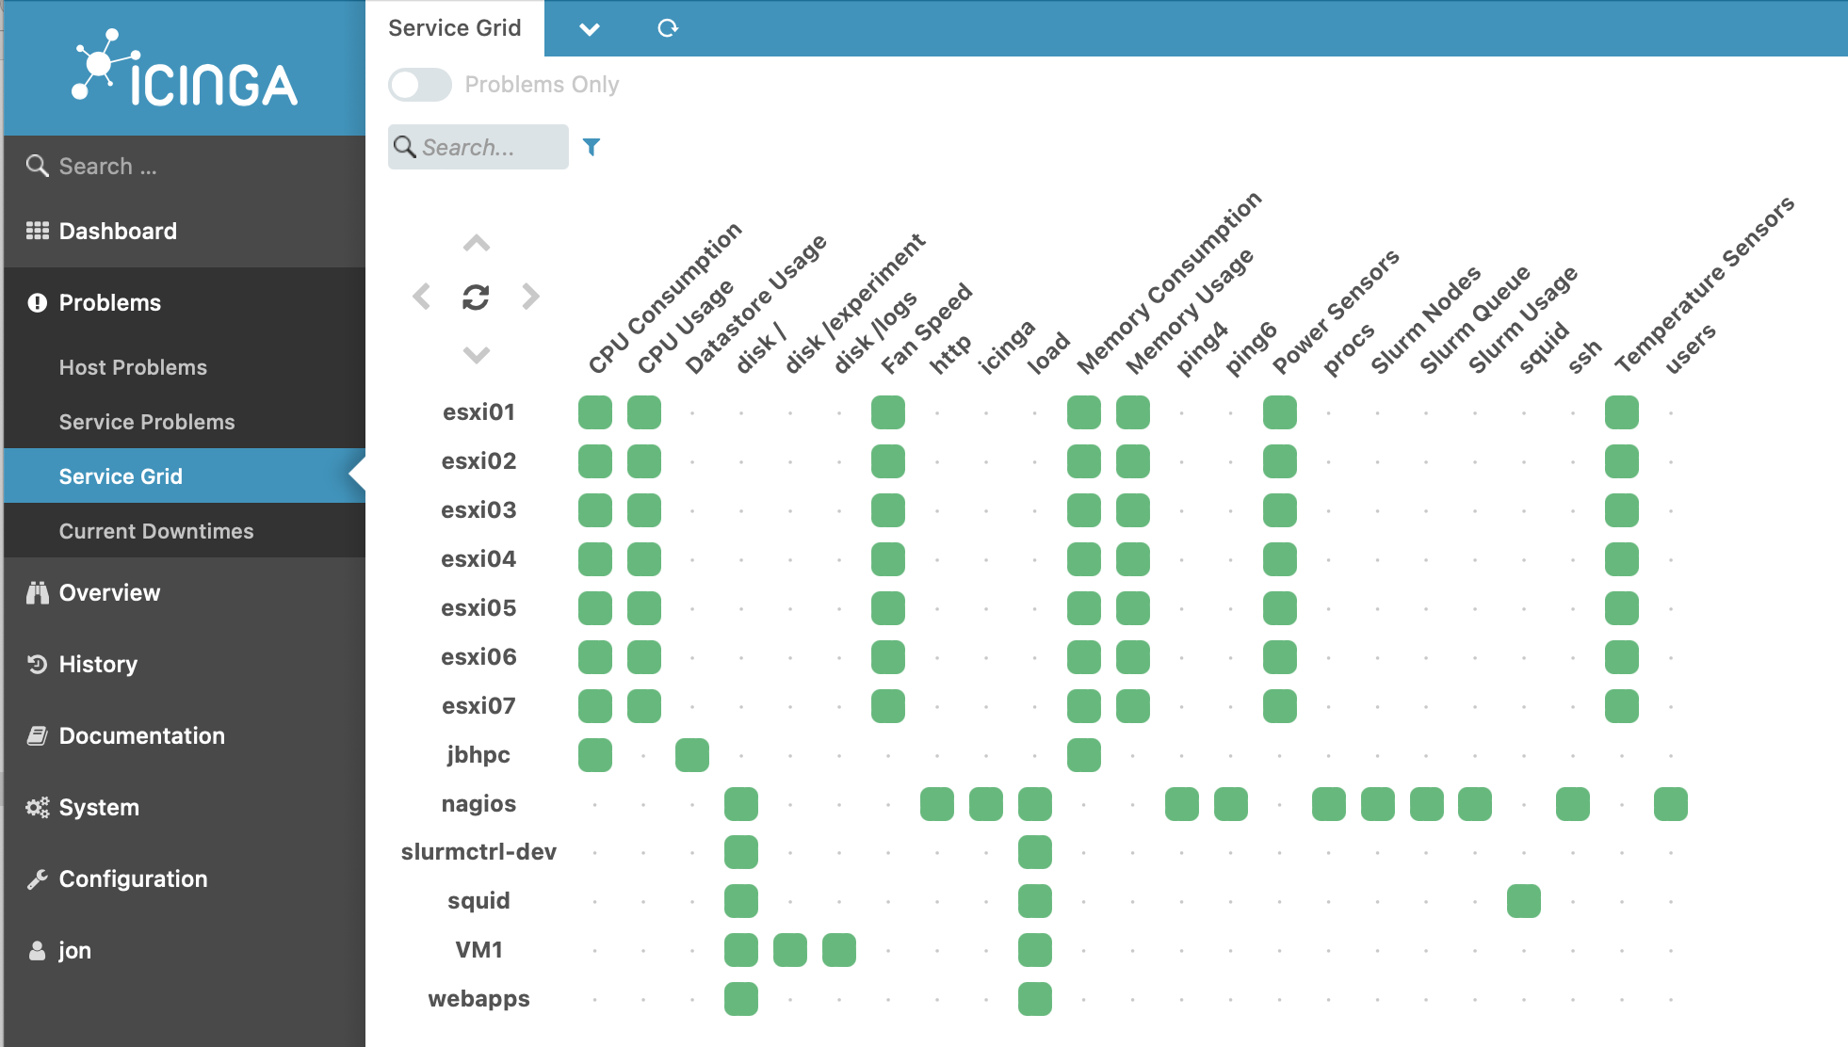
Monitoring Services Aggregate System Status
Notes:
Once we decide the metrics to track, we can aggregate them into one place to see the overall system status. For example, here is a screenshot of the open-source monitoring platform called Iciniga (good luck pronouncing it, try Aye-Singa)’s “Service grid” overview, which shows all of the services that are being tracked, all of the KPIs that are being tracked, and the overall status of each KPI on each service

Slide 16
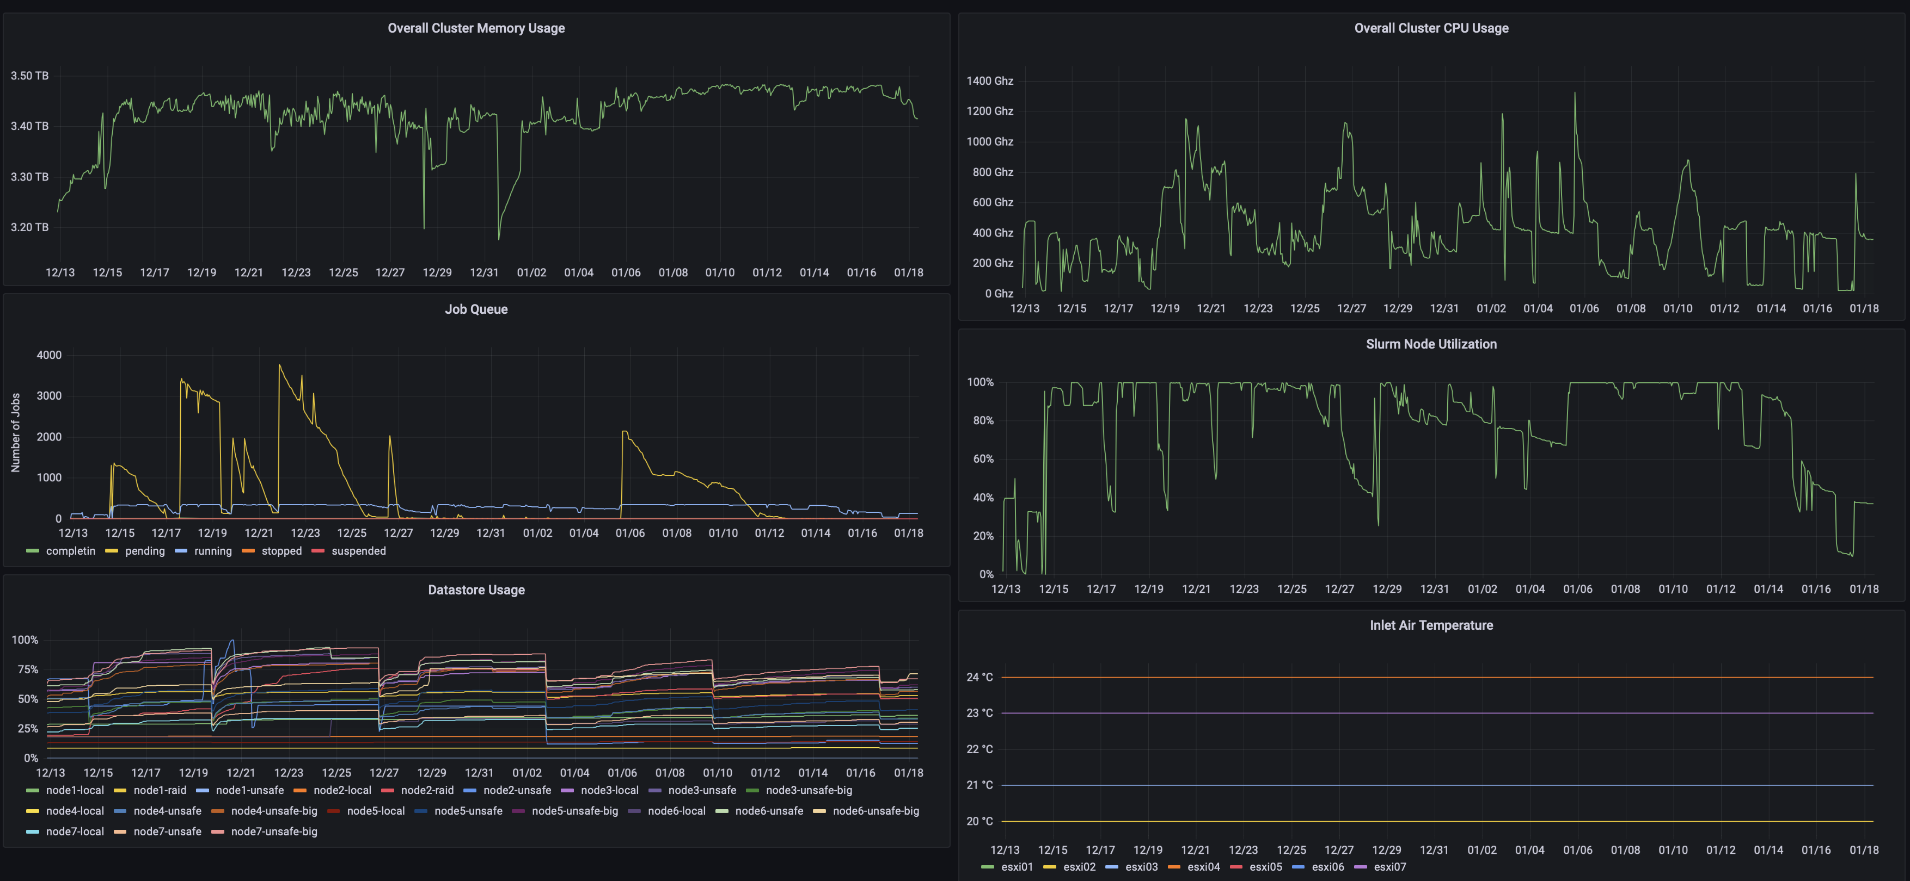
Monitoring Dashboards Help Gather Insights
Notes:
Dashboards that aggregate multiple KPIs into one place allow a human operator to gather insights by putting in one place all of the kinds of metrics that we just saw:
Hardware-level KPIS (like memory usge and CPU usage, datastore usage),
application-level KPIs (like number of jobs waiting to be processed in some queue, and system utilization),
And even environmental KPIs (like ambient air temperature at the fan inlet on the physical machines)
Once data like this is being tracked, it’s easier to gain high-level insights by plotting it and using an interactive interface to query it. This screenshot is taken from an open-source analytics and interactive visualization product called Grafana.
But it’s also easy to automate processes around this data

Slide 17
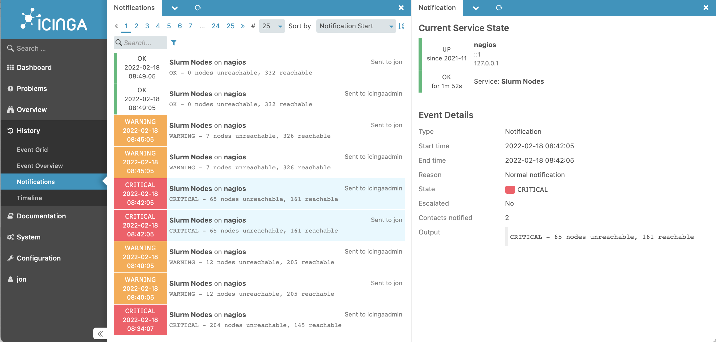
Monitoring Services Take Automated Actions
Notes:
Once we are monitoring these KPIs, it’s also possible to set up automated processes that take actions when certain events happen. Here’s a screenshot of another view of Icinga. One of the key kinds of actions that Icinga is designed to take is to simply track problems and run a series of escalating notifications to ensure that they get noticed and resolved. In this screenshot, you can see the various times that the “slurm nodes” application service degraded and then eventually entirely failed on Feb 18. Each entry shows a notification that was sent.

Slide 18
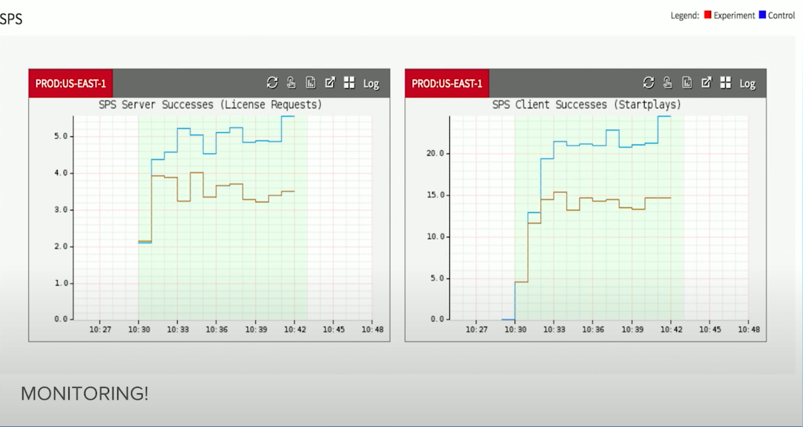
Monitoring Services Take Automated Actions
Automatically detecting irregular behavior at Netflix
https://www.youtube.com/watch?v=qyzymLlj9ag
Notes:
In a real production scenario, we probably want to automate even more of a response than simply sending a notification.
Here is an example of application-level monitoring in practice, from Netflix. These monitoring graphs plot SPS, which is Netflix’s key business metric: “Stream starts per second” - can a user actually watch what they want to watch.
Graph shows a comparison between a “control” group (running old version of software, blue) and an “experiment” group (running new version proposed, shown in red). If SPS deviates between control and expected, auto-rollback occurs within seconds; no

